Slide 1
Data Provenance: Why and How
Lars Vilhuber
Cornell University
2020-10-09
The opinions expressed in this talk are solely the author’s, and do not represent the views of the U.S. Census Bureau, the American Economic Association, or any of the funding agencies.
© Lars Vilhuber .
Notes:
I am going to
Very briefly describe the background we are coming from
Describe some of the challenges
Provide some guidance based on the lessons learned

Slide 2
On the menu today
Data provenance: what you want is what you should get
Data citations: what you got is not yours

Slide 3

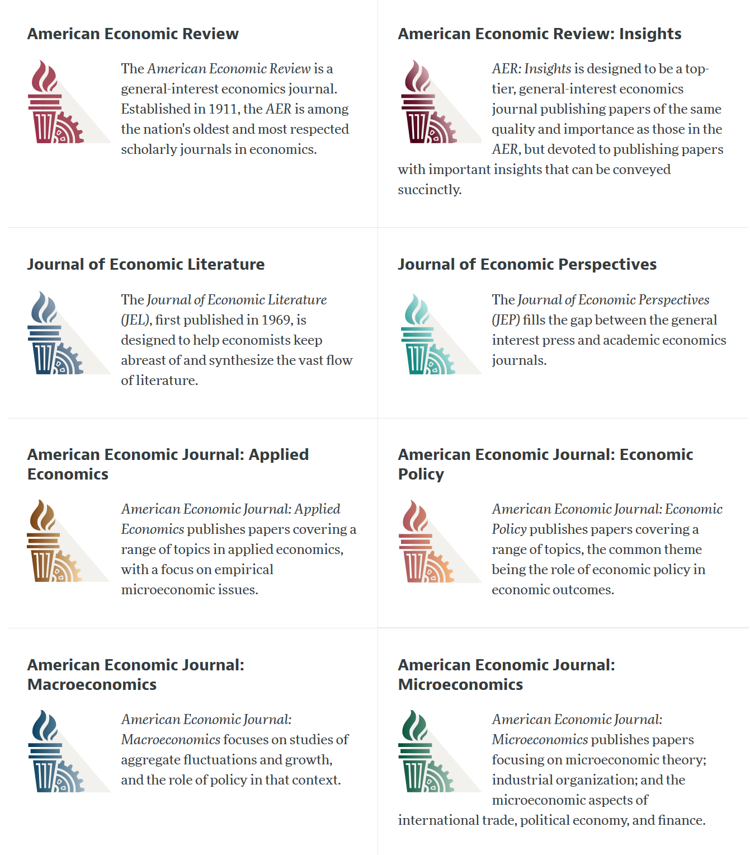

Slide 4
AEA Data & Code Availability Policy (2019)
It is the policy of the American Economic Association to publish papers only if the data used in the analysis are clearly and precisely documented and access to the data and code is clearly and precisely documented and is non-exclusive to the authors.
Authors of accepted papers that contain empirical work, simulations, or experimental work must provide, prior to acceptance, the data, programs, and other details of the computations sufficient to permit replication, as well as information about access to data and programs.

Slide 5
Current efforts at the AEA
Pre-emptively improve code archives
By conducting reproducibility checks when we can
By working with groups that conduct reproducibility checks when we cannot
Better archives
Greater transparency of the code and data archives
Better provenance tracking
Leave code where it is when appropriate
Leave data where it is almost always
Display that information
Notes:
Add logo from AEA

Slide 6

Replication continuum
https://doi.org/10.17226/25303
08
08
08
Reproducibility
Replicability
Generalizability
Narrow Replication (Pesaran 2003)
Pure Replication (Hamermesh 2007)
Verification (Clemens 2015)
Wide Replication (Pesaran 2003)
Statistical Replication (Hamermesh 2007)
Reproduction/Reanalysis (Clemens 2015)
Wider Replication (Pesaran 2003)
Scientific Replication (Hamermesh 2007)
Reanalysis/Robustness (Clemens 2015)

Slide 7
Replication continuum
Same data | Same code | Same methods | Same context
08
Reproducibility
Narrow Replication (Pesaran 2003)
Pure Replication (Hamermesh 2007)
Verification (Clemens 2015)

Slide 8
Data provenance

Slide 9
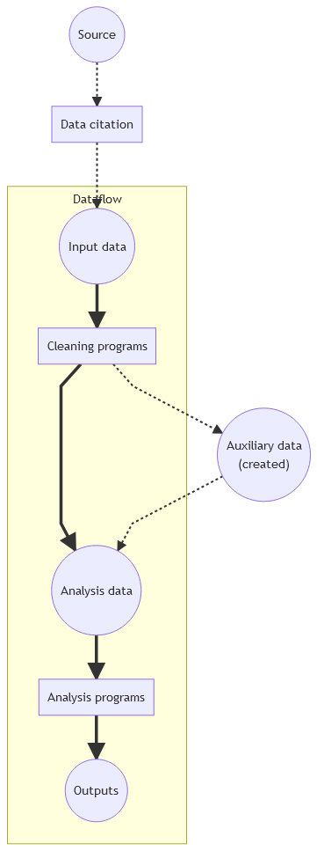
Simplified model
Basic data-oriented flow
Historically: analysis data
More recently: input data, too
But where does it come from? (“provenance”)

Slide 10
Poor citation practices
Macrodata:
“We use data downloaded from the Bureau of Economic Analysis…”
Microdata:
“… this paper uses data from the Current Population Survey…”

Slide 11
An analogy…

Slide 12
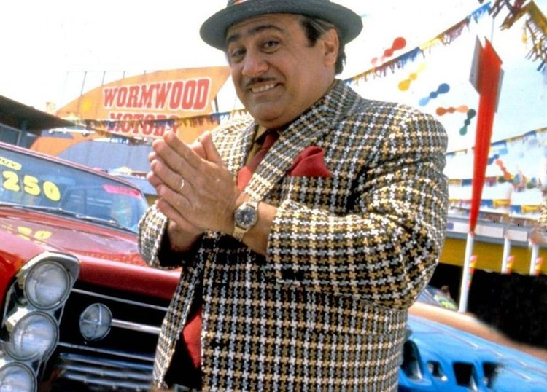
Would you buy a car from this guy?

Slide 13
Provenance!
Does the sales person have a good record?
Where does the car come from?
What do we know about the car?

Slide 14

You don’t want end up like this
Source: Adri Marie from Pixabay (Pixabay License)

Slide 15
Translating into the data world

Slide 16
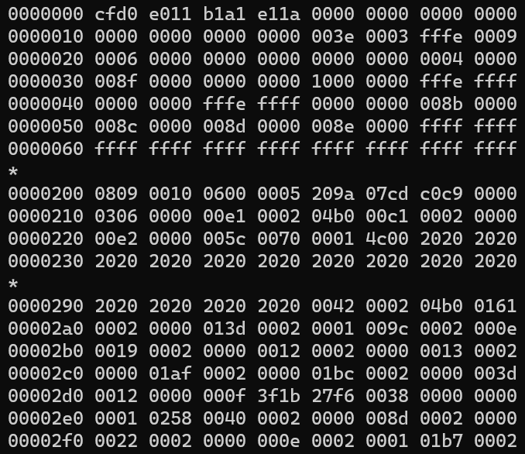
Would you use this data?

Slide 17
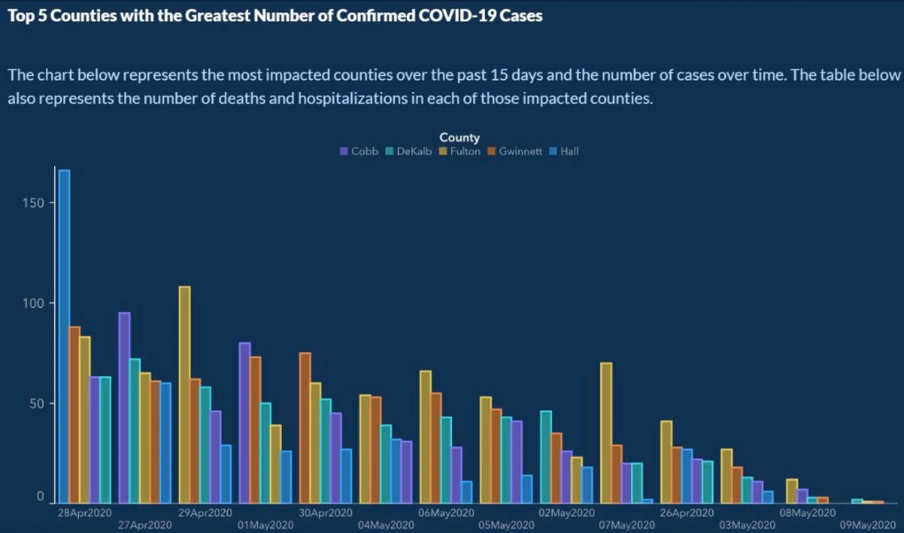
Or would you trust this data?

Slide 18
Provenance!
Does the provider have a good record?
Where do the data come from?
What do we know about the data?
Metadata!

Slide 19
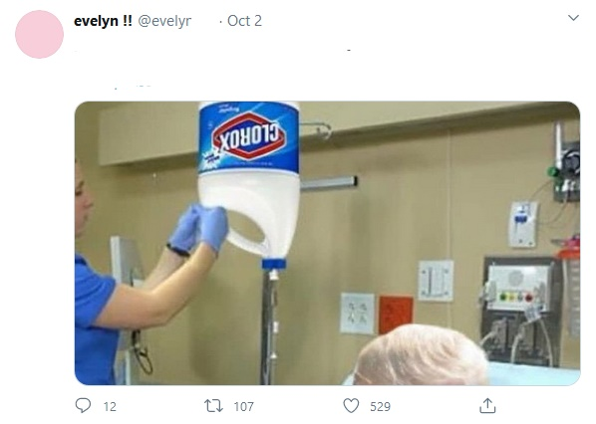
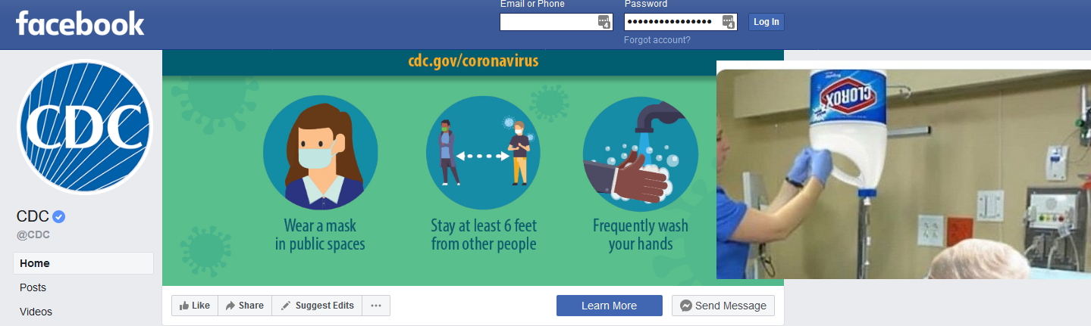
Provenance!
“CDC warns not to ingest Lysol.”
“It suggests that Clorox is better.”

Slide 20
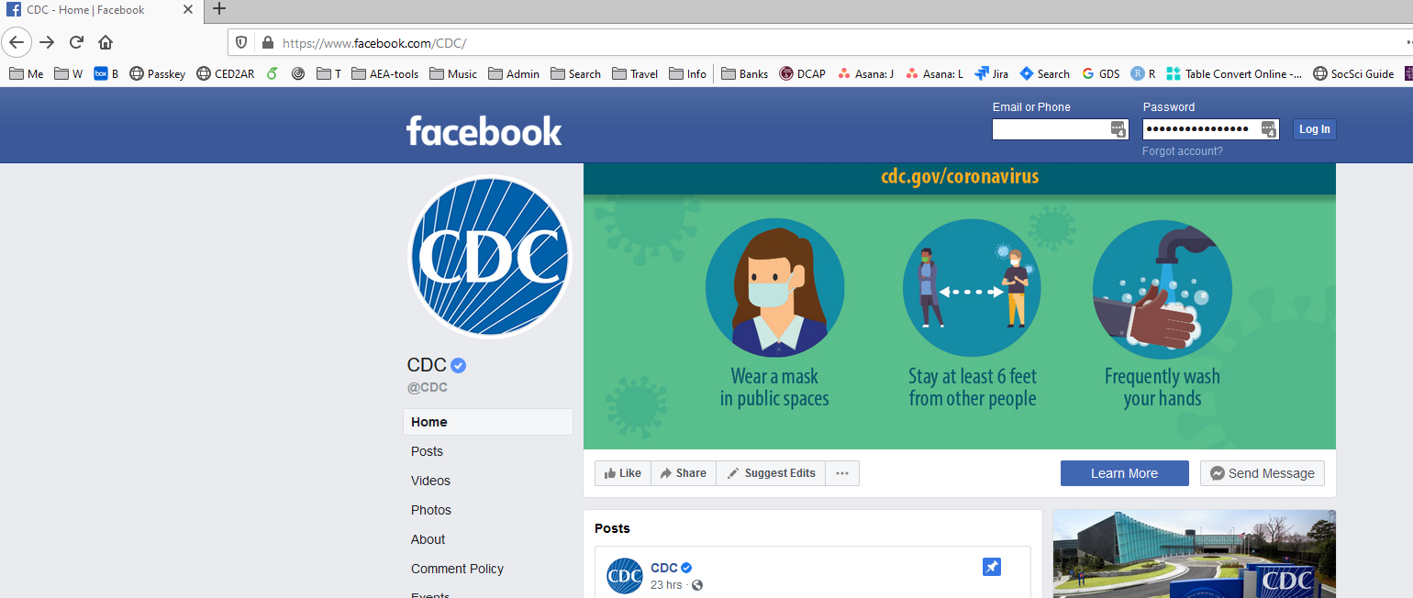
Find the source!

Slide 21
“It’s a file called stockmarket.xlsx”
2101.49
2057.64
2063.11
2077.42
2076.78
0
2068.76
2081.34
2046.68
2051.31
2076.62
2099.60
2108.95
2107.40
2124.29
2126.64
2128.28
2119.21
2114.15
2102.15
2079.65
2067.64
2093.25
2108.57
2108.63
2103.84

Slide 22
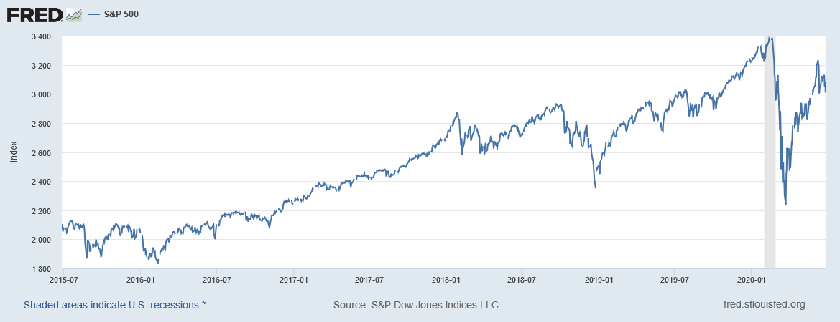
“It’s a file called SP500.xlsx”
SP500 | S&P 500, Index, Daily, Not Seasonally Adjusted
Frequency: Daily, Close
observation_date | SP500
2015-06-26 | 2101.49
2015-06-29 | 2057.64
2015-06-30 | 2063.11
2015-07-01 | 2077.42
2015-07-02 | 2076.78
2015-07-03 | 0
2015-07-06 | 2068.76
2015-07-07 | 2081.34
2015-07-08 | 2046.68
2015-07-09 | 2051.31
2015-07-10 | 2076.62
2015-07-13 | 2099.60
2015-07-14 | 2108.95
2015-07-15 | 2107.40
2015-07-16 | 2124.29
2015-07-17 | 2126.64
2015-07-20 | 2128.28

Slide 23
“It’s a file called SP500.xlsx, downloaded from FRED.”
SP500 | S&P 500, Index, Daily, Not Seasonally Adjusted
Frequency: Daily, Close
observation_date | SP500
2015-06-26 | 2101.49
2015-06-29 | 2057.64
2015-06-30 | 2063.11
2015-07-01 | 2077.42
2015-07-02 | 2076.78
2015-07-03 | 0
2015-07-06 | 2068.76
2015-07-07 | 2081.34
2015-07-08 | 2046.68
2015-07-09 | 2051.31
2015-07-10 | 2076.62
2015-07-13 | 2099.60
2015-07-14 | 2108.95
2015-07-15 | 2107.40
2015-07-16 | 2124.29
2015-07-17 | 2126.64
2015-07-20 | 2128.28

Slide 24
“It’s a file called SP500.xlsx, downloaded from FRED.”
S&P Dow Jones Indices LLC. 2020. “S&P 500 [SP500] [dataset]”, retrieved from FRED, Federal Reserve Bank of St. Louis; https://fred.stlouisfed.org/series/SP500, June 26, 2020.
SP500 | S&P 500, Index, Daily, Not Seasonally Adjusted
Frequency: Daily, Close
observation_date | SP500
2015-06-26 | 2101.49
2015-06-29 | 2057.64
2015-06-30 | 2063.11
2015-07-01 | 2077.42
2015-07-02 | 2076.78
2015-07-03 | 0
2015-07-06 | 2068.76
2015-07-07 | 2081.34
2015-07-08 | 2046.68
2015-07-09 | 2051.31
2015-07-10 | 2076.62
2015-07-13 | 2099.60
2015-07-14 | 2108.95
2015-07-15 | 2107.40
2015-07-16 | 2124.29
2015-07-17 | 2126.64
2015-07-20 | 2128.28

Slide 25
We’re all set then.

Slide 26
“SP500.xlsx, from S&P (2020). Not provided as part of replication package because © S&P. ”
S&P Dow Jones Indices LLC. 2020. “S&P 500 [SP500] [dataset]”, retrieved from FRED, Federal Reserve Bank of St. Louis; https://fred.stlouisfed.org/series/SP500, June 26, 2020.
SP500 | S&P 500, Index, Daily, Not Seasonally Adjusted
Frequency: Daily, Close
observation_date | SP500
2015-06-26 | 2101.49
2015-06-29 | 2057.64
2015-06-30 | 2063.11
2015-07-01 | 2077.42
2015-07-02 | 2076.78
2015-07-03 | 0
2015-07-06 | 2068.76
2015-07-07 | 2081.34
2015-07-08 | 2046.68
2015-07-09 | 2051.31
2015-07-10 | 2076.62
2015-07-13 | 2099.60
2015-07-14 | 2108.95
2015-07-15 | 2107.40
2015-07-16 | 2124.29
2015-07-17 | 2126.64
2015-07-20 | 2128.28

Slide 27
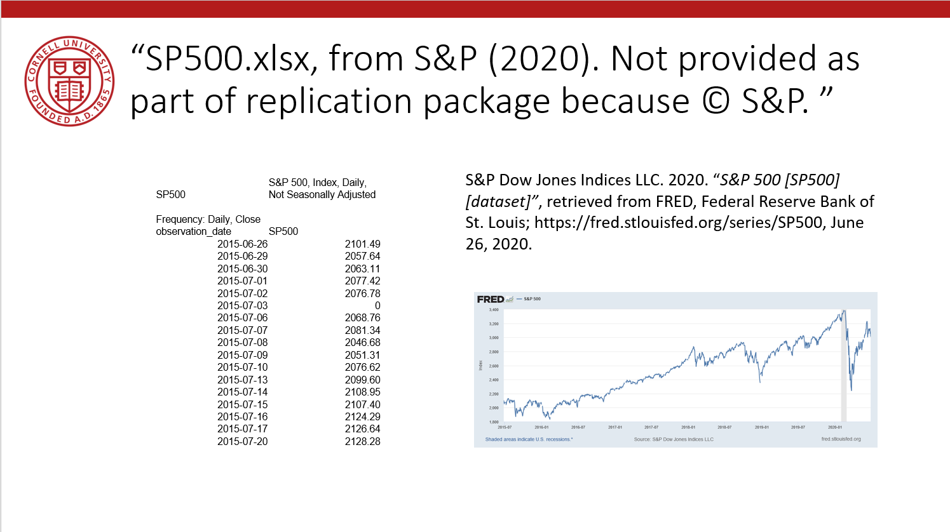
Data Availability Statements
Describes data file, where to get it, how to get it, and any conditions of obtaining it

Slide 28
Data Citation
Attributes the file to the proper source

Slide 29
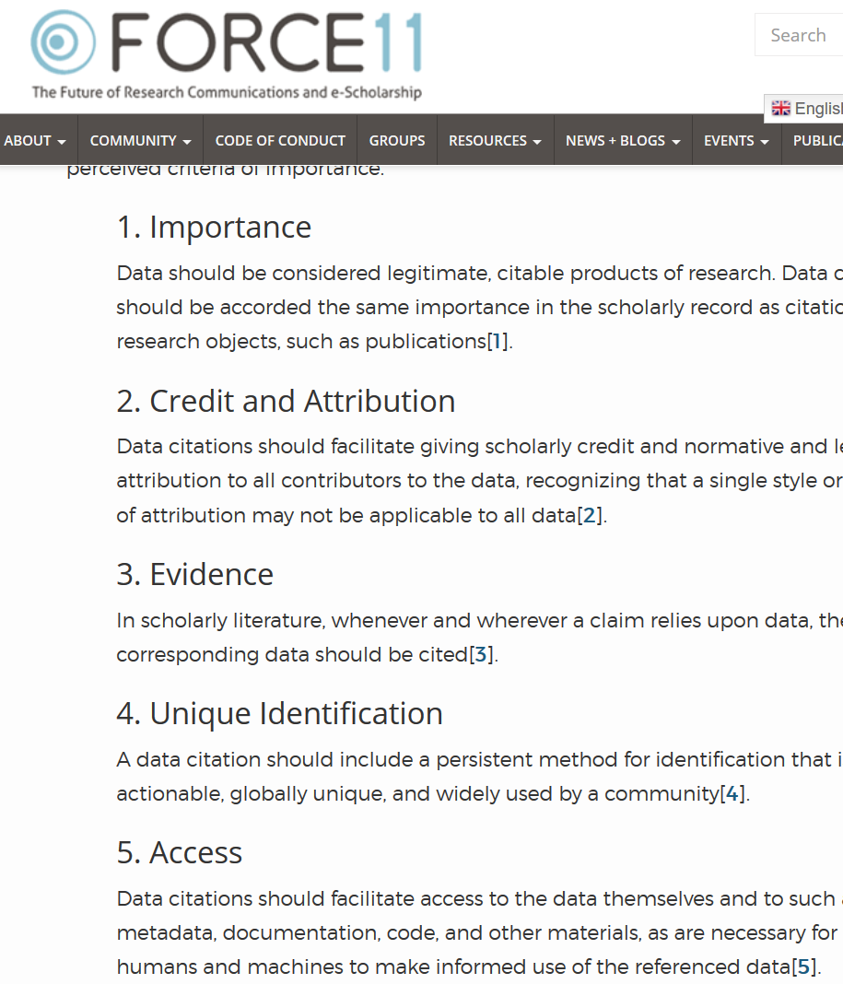

Starts with Data Citations
Data Citation Principles
Image of a standard data citation
Data Citation Synthesis Group: Joint Declaration of Data Citation Principles. Martone M. (ed.) San Diego CA: FORCE11; 2014 [https://www.force11.org/group/joint-declaration-data-citation-principles-final].

Slide 30
Data Citations are Hard!

Slide 31
At the AEA, every manuscript is checked
What datasets are used
Are they cited?
Is there additional information on access?
Is there license/ data use information?
→ Should the author provide the data?
→ Is the author allowed to provide data?

Slide 32
Data Rights

Slide 33
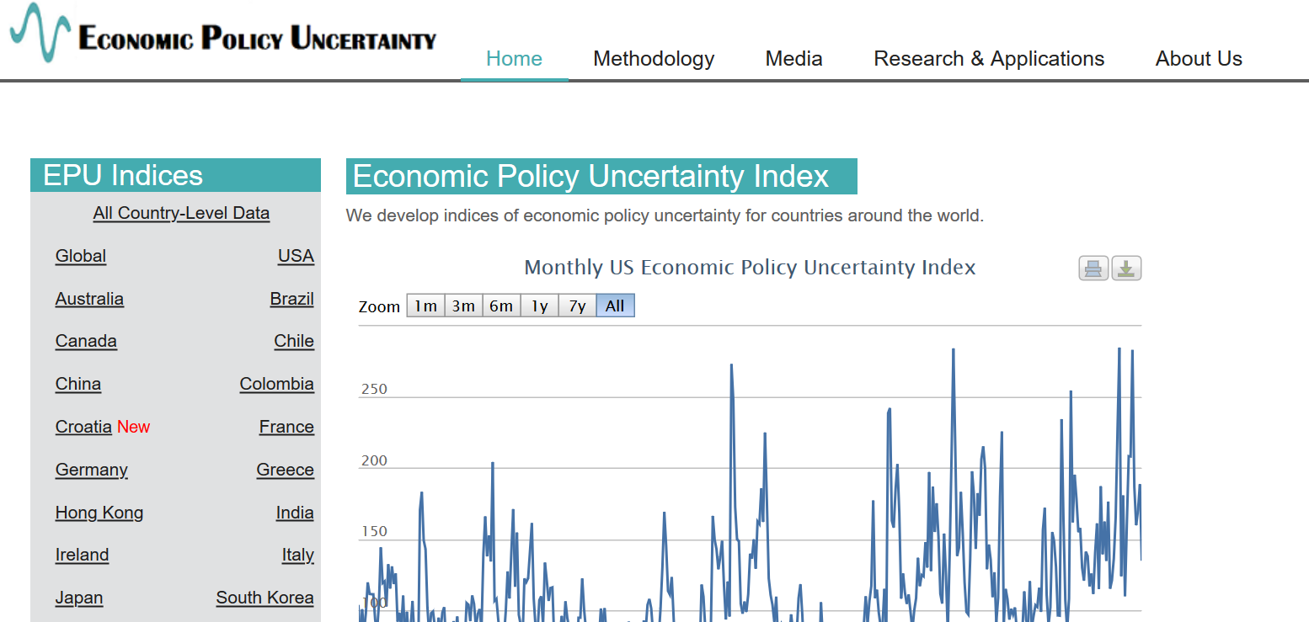
Example 2: Academic data publisher

Slide 34

Example 2: Academic data publisher

Slide 35

Example 2: Academic data publisher-new!

Slide 36
Rights to use data
You browsed a website
You purchased the data
You signed a data use agreement
You created the data (lab experiment)
You had survey respondents consent to use (IRB approval!)

Slide 37
Rights to distribute the data
If you created the data, you decide.
If you got it from somewhere else:
READ THE TERMS OF USE / DATA USE AGREEMENT / CLICK-THROUGH / ETC.

Slide 38
Rights around data
Usage rights
You browsed a website
You purchased the data
You signed a data use agreement
You created the data (lab experiment)
You had survey respondents consent to use (IRB approval!)
Redistribution rights
If you created the data, you decide.
If you got it from somewhere else:
READ THE TERMS OF USE / DATA USE AGREEMENT / CLICK-THROUGH / ETC.

Slide 39
Citing restricted-access data
“Well, I can’t download the data, so I can’t cite it.”

Slide 40
Wrong

Slide 41
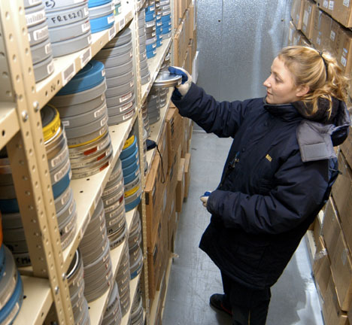
These are archives
Source: https://chiddicksfamilytree.com/2017/11/08/use-it-or-lose-it/
Source: https://www.archives.gov/publications/prologue/2008/spring/frc.html

Slide 42
They are citable
Typescript of short story Brothers and Sisters by Budge Wilson, 2000, MS-2-650.2013-070, Box 3, Folder 9, Budge Wilson fonds, Dalhousie University Archives, Halifax, Nova Scotia, Canada.

Slide 43
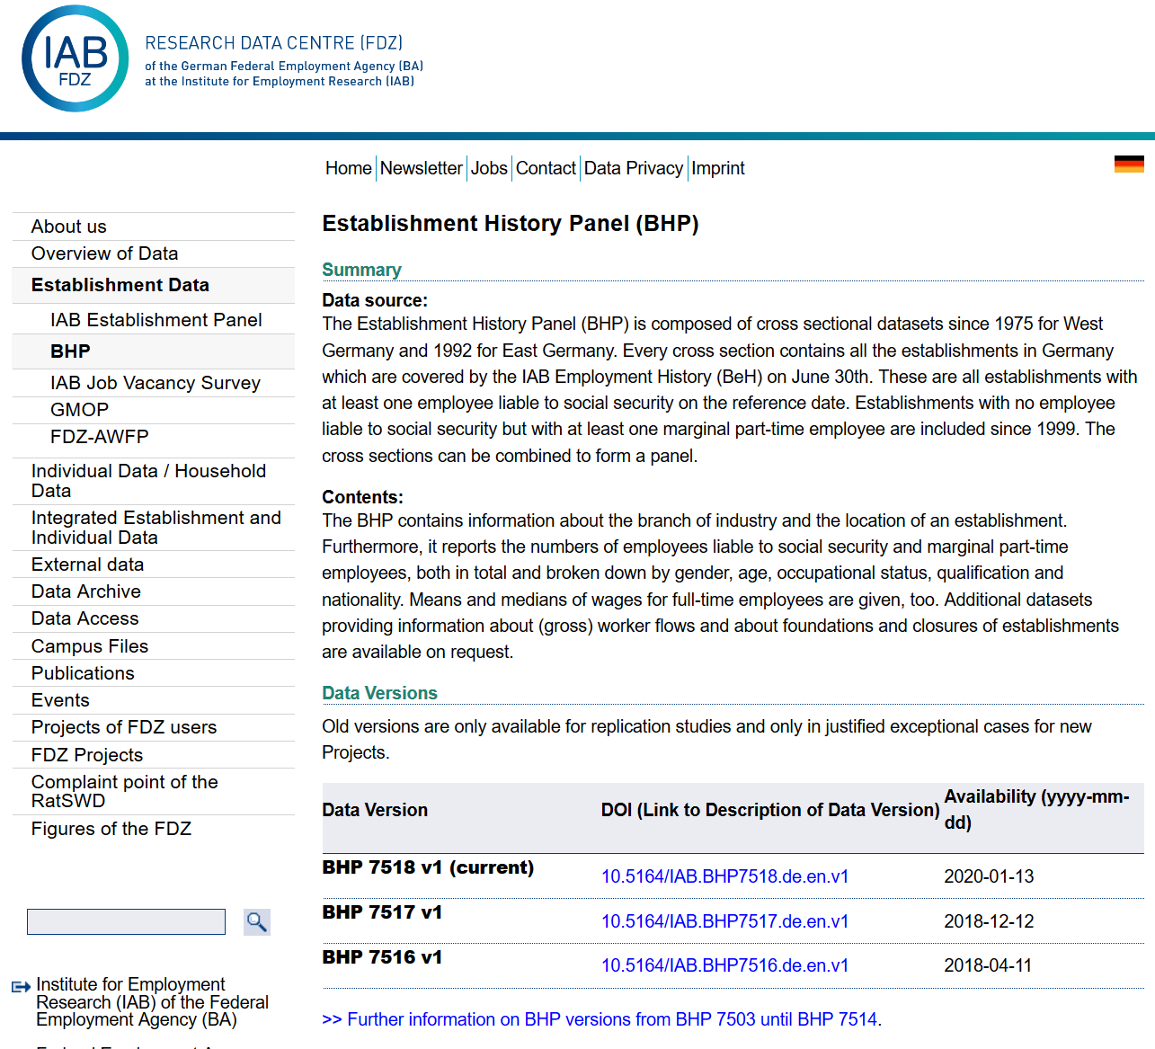
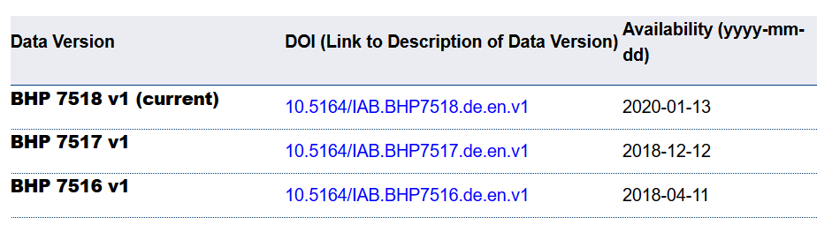
Example 4: German Restricted-access

Slide 44
Example 4: German Restricted-access

Slide 45

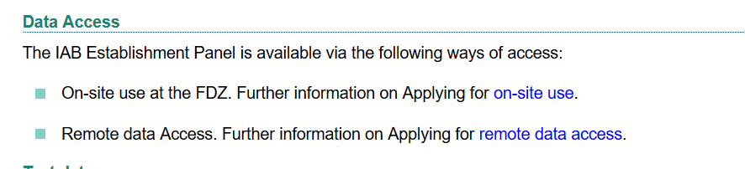
Example 4: German Restricted-access

Slide 46
Element of a (data) citation
CMOS notes (16th ed., 14.1)
“Regardless of the convention being followed, source citations must always provide sufficient information either to lead readers directly to the sources consulted or, for materials that may not be readily available, to enable readers to positively identify them, regardless of whether the sources are published or unpublished or in printed or electronic form.”
ICPSR notes that a citation should include the following items:
Author
Title
Distributor
Date
Version
Persistent identifier

Slide 47
Element of a (data) citation
ICPSR notes that a citation should include the following items:
Author
Title
Distributor
Date
Version
Persistent identifier
Suggested Citation:
S&P Dow Jones Indices LLC, S&P 500 [SP500], retrieved from FRED, Federal Reserve Bank of St. Louis; https://fred.stlouisfed.org/series/SP500, June 26, 2020.

Slide 48
Element of a (data) citation
ICPSR notes that a citation should include the following items:
Author
Title
Distributor
Date
Version
Persistent identifier
Constructed Citation:
Institute for Employment Research (IAB), Establishment History Panel 1975-2018. Accessed via the Research Data Centre (FDZ) of the German Federal Employment Agency DOI: 10.5164/IAB.BHP7518.de.en.v1 June 26, 2020.

Slide 49
Element of a (data) citation
ICPSR notes that a citation should include the following items:
Author
Title
Distributor
Date
Version
Persistent identifier
Constructed Citation:
US Census Bureau, Longitudinal Business Database (LBD) 1975-2018. Last accessed via the Federal Statistical Research Data Centre (FSRDC) June 26, 2020.

Slide 50
And we check them!
If the URL does not work, we make a note.
If the site requires registration, we try it out.
How long?
Any requirements?
What does the site say?
Please use the following citation when referring to this file in the different versions: Inglehart, R., C. Haerpfer, A. Moreno, C. Welzel, K. Kizilova, J. Diez-Medrano, M. Lagos, P. Norris, E. Ponarin & B. Puranen et al. (eds.). 2014. World Values Survey: Round Six - Country-Pooled Datafile Version: www.worldvaluessurvey.org/WVSDocumentationWV6.jsp. Madrid: JD Systems Institute.
Is that in the README / Paper/ Appendix?

Slide 51
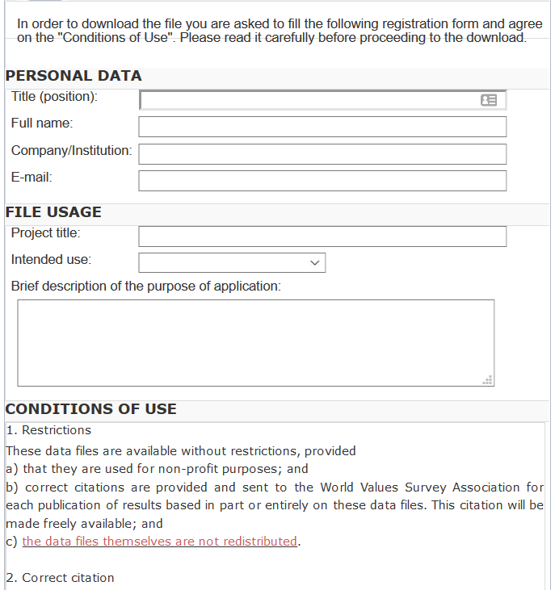
And we check them!
What does the site say?
Please use the following citation when referring to this file in the different versions: Inglehart, R., C. Haerpfer, A. Moreno, C. Welzel, K. Kizilova, J. Diez-Medrano, M. Lagos, P. Norris, E. Ponarin & B. Puranen et al. (eds.). 2014. World Values Survey: Round Six - Country-Pooled Datafile Version: www.worldvaluessurvey.org/WVSDocumentationWV6.jsp. Madrid: JD Systems Institute.
Is that in the README / Paper/ Appendix?
Are all the conditions met/described?

Slide 52
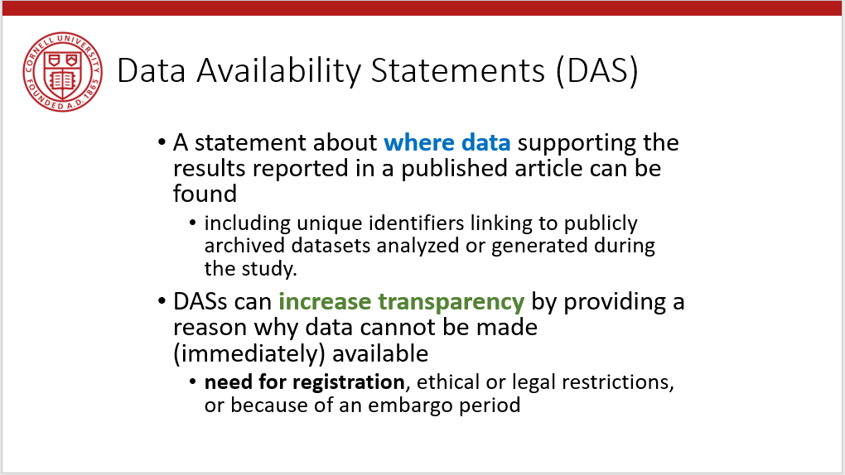
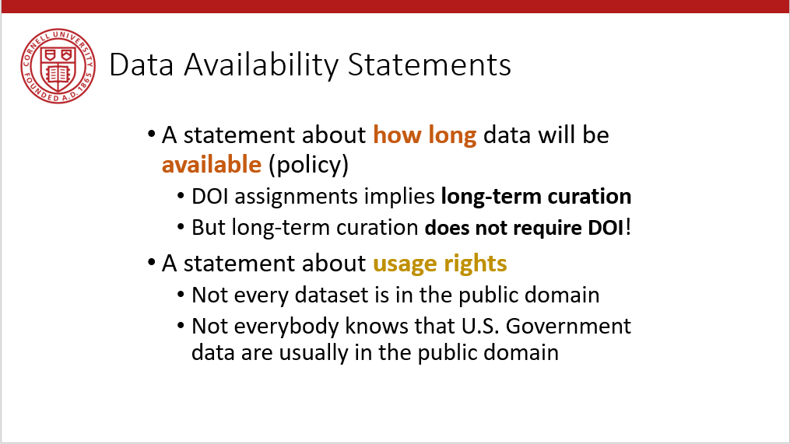
Provide data citations (in manuscript) and data availability statements (in README or appendix)

Slide 53
Take-away

Slide 54
Data: Citations, Access, Rights
Any data can be cited – even if you can’t download it
Any data that you accessed … can have that access be described
But caution: It should be such that others can also repeat the access!
Just because you “have” the data does not mean you can give it to others
Also: distinguish between “sharing” and “publishing”
Know your terms of use!

Slide 55

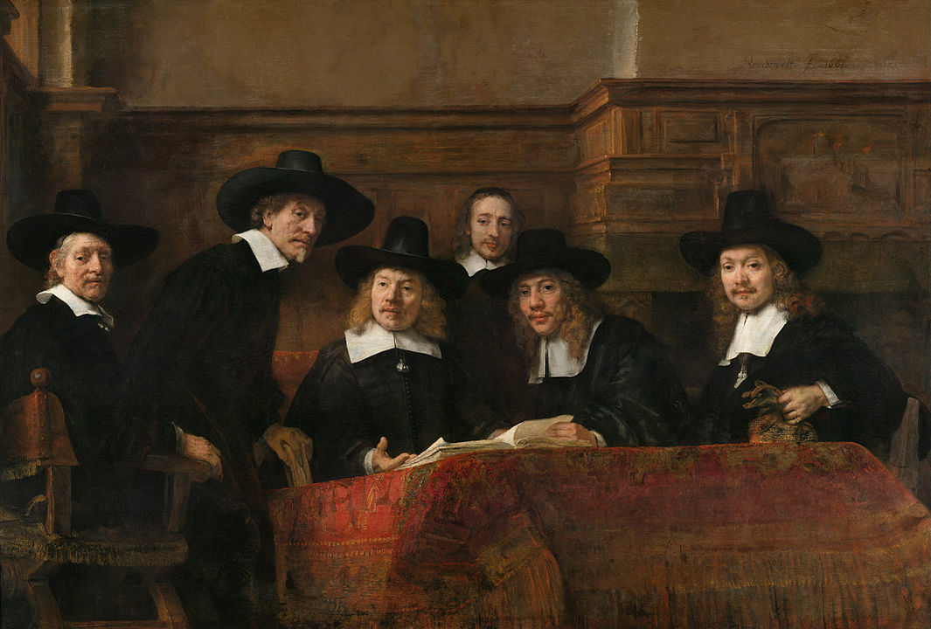
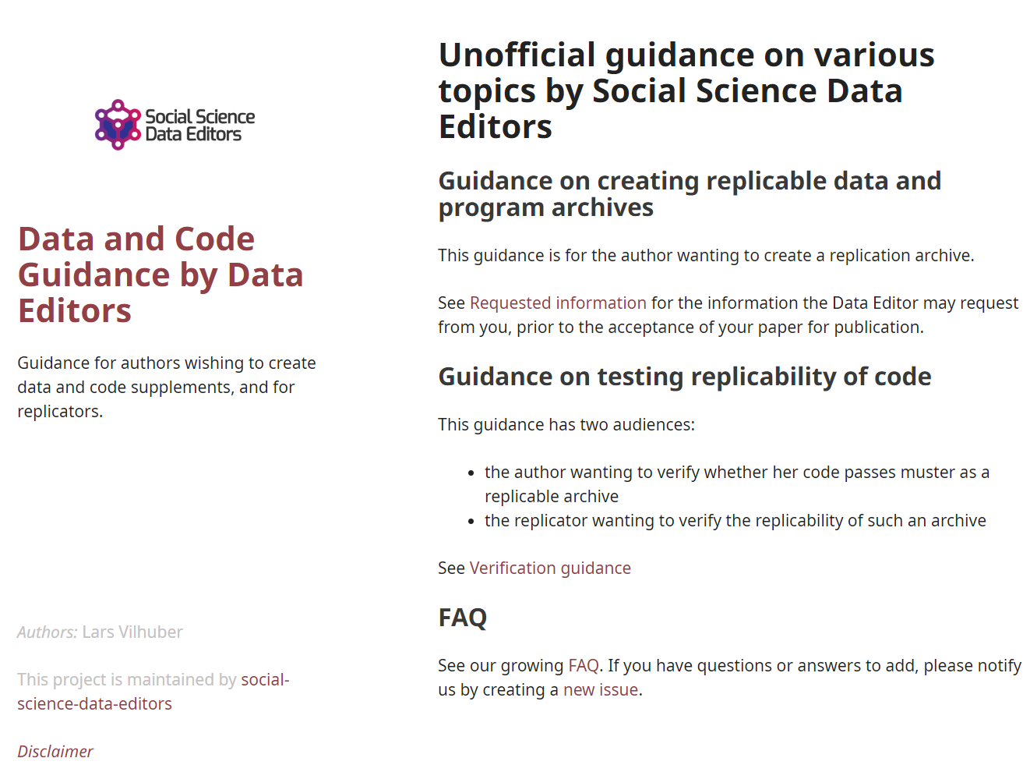
Social science “guild”
https:// social-science -data-editors. github.io/ guidance/

Slide 56
Thank you!
https://doi.org/10.5281/zenodo.4073995

Slide 57

Some resources
https://social-science-data-editors.github.io/guidance/
https://aeadataeditor.github.io/aea-de-guidance/
template README
discussion of licensing
data citation guidance
German example:
Establishment History Panel (BHP) DOI: 10.5164/IAB.BHP7516.de.en.v1

